Slide 1
Advanced Encryption Standard
This lecture is mainly based on the power point slides by Professor Lawrie Brown.
Notes:
Zili Shao

Slide 2
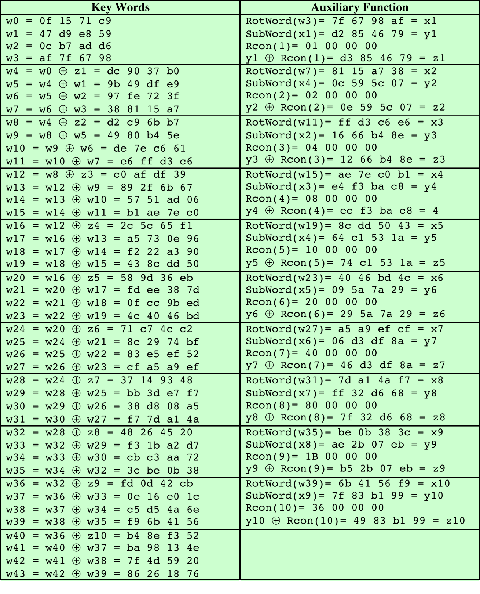
Table 6.4
AES Example Key Expansion
(Table is located on page 168
in textbook)
Notes:
Table 5.3 shows the expansion of the 16-byte key into 10 round keys. As previously
explained, this process is performed word by word, with each four-byte word occupying
one column of the word round-key matrix. The left-hand column shows
the four round-key words generated for each round. The right-hand column shows
the steps used to generate the auxiliary word used in key expansion. We begin, of
course, with the key itself serving as the round key for round 0.

Slide 3
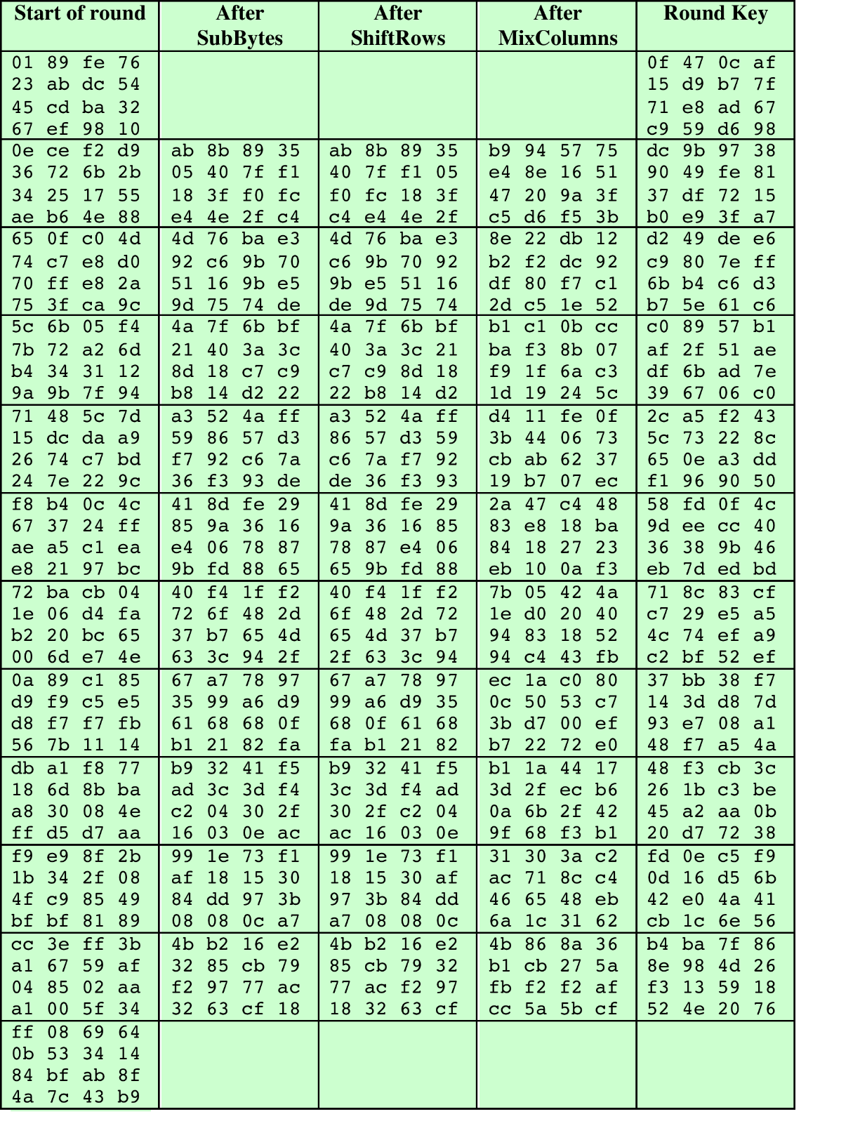

Table 6.5
AES Example
Key: 0f1571c947d9e8590cb7add6af7f6798
(Table is located on page 169
in textbook)
Notes:
Next, Table 5.4 shows the progression of State through the AES encryption
process. The first column shows the value of State at the start of a round. For the
first row, State is just the matrix arrangement of the plaintext. The second, third, and
fourth columns show the value of State for that round after the SubBytes, ShiftRows,
and MixColumns transformations, respectively. The fifth column shows the round
key. You can verify that these round keys equate with those shown in Table 5.3. The
first column shows the value of State resulting from the bitwise XOR of State after
the preceding MixColumns with the round key for the preceding round.

Slide 4
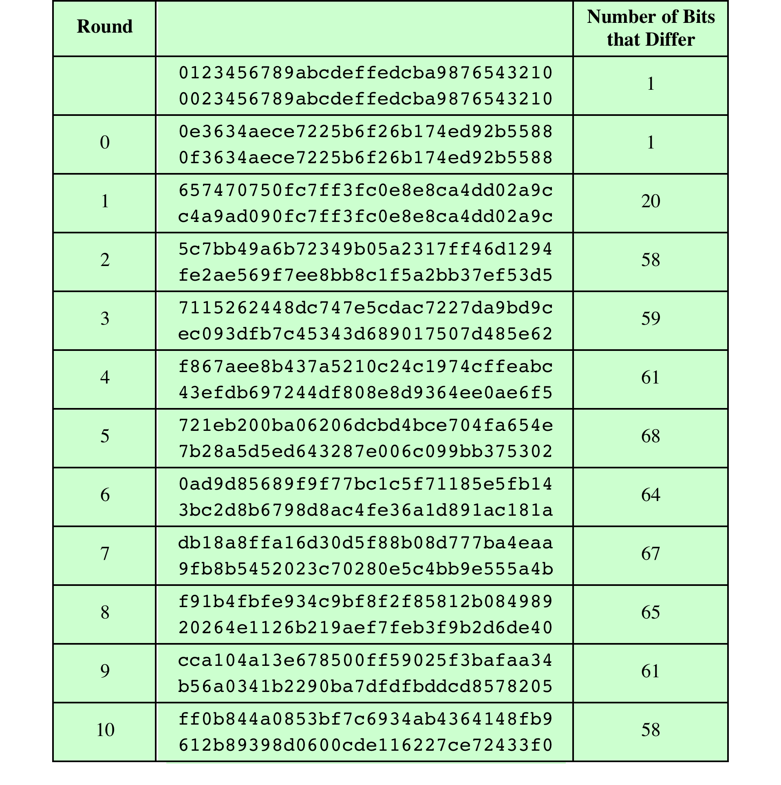
Table 6.6
Avalanche Effect
in AES: Change in Plaintext
Key: 0f1571c947d9e8590cb7add6af7f6798
(Table is located on page 170
in textbook)
Notes:
If a small change in the key or plaintext were to produce a corresponding small
change in the ciphertext, this might be used to effectively reduce the size of the
plaintext (or key) space to be searched. What is desired is the avalanche effect, in
which a small change in plaintext or key produces a large change in the ciphertext.
Using the example from Table 5.4, Table 5.5 shows the result when the
eighth bit of the plaintext is changed. The second column of the table shows the
value of the State matrix at the end of each round for the two plaintexts. Note
that after just one round, 20 bits of the State vector differ. After two rounds,
close to half the bits differ. This magnitude of difference propagates through
the remaining rounds. A bit difference in approximately half the positions in the
most desirable outcome. Clearly, if almost all the bits are changed, this would be
logically equivalent to almost none of the bits being changed. Put another way, if
we select two plaintexts at random, we would expect the two plaintexts to differ
in about half of the bit positions and the two ciphertexts to also differ in about
half the positions.

Slide 5
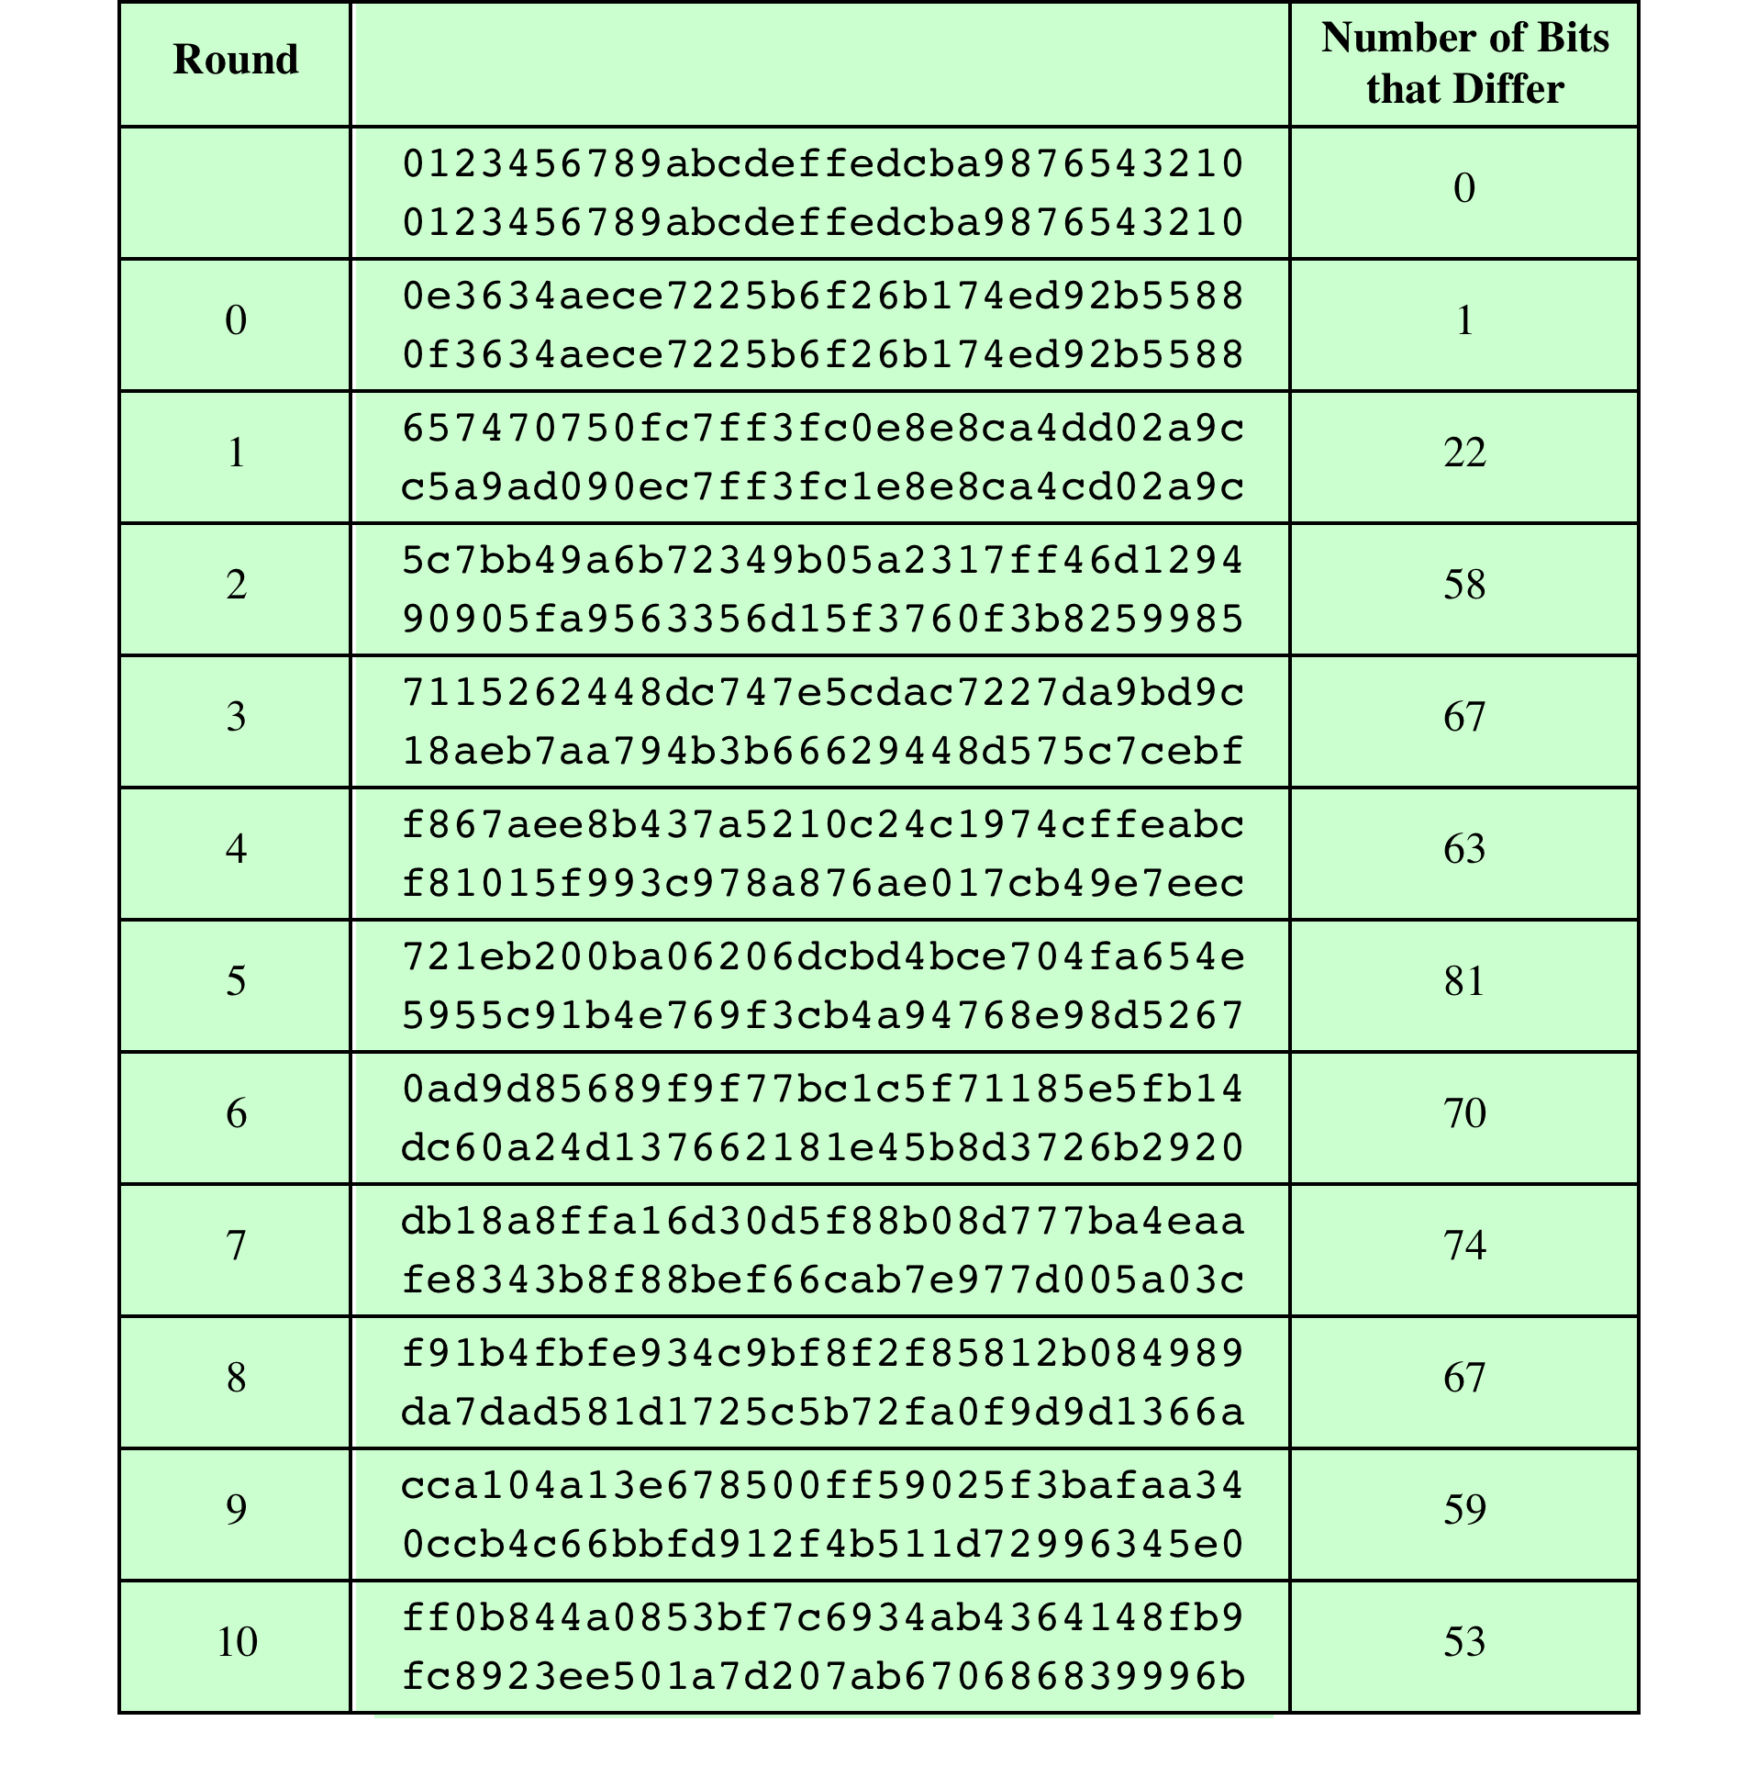
Table 6.7
Avalanche Effect in AES: Change in Key
Key: 0f1571c947d9e8590cb7add6af7f6798
0e1571c947d9e8590cb7add6af7f6798
(Table is located on page 171
in textbook)
Notes:
Table 5.6 shows the change in State matrix values when the same plaintext is
used and the two keys differ in the eighth bit. That is, for the second case, the key is
0e1571c947d9e8590cb7add6af7f6798. Again, one round produces a significant
change, and the magnitude of change after all subsequent rounds is roughly half
the bits. Thus, based on this example, AES exhibits a very strong avalanche effect.
Note that this avalanche effect is stronger than that for DES (Table 3.2),
which requires three rounds to reach a point at which approximately half the bits
are changed, both for a bit change in the plaintext and a bit change in the key.

